Slide 1
US Accidents Analysis
Ahmed Osama Helmy Abdallah Ahmed
Aliaa Gheis Omar Mahmoud

Slide 2
Problem Definition
Road safety is a critical concern, and understanding accident patterns can help cities improve traffic management and reduce accident rates.
This project aims to analyze accident data to identify high-risk locations, contributing factors, and potential mitigation strategies.
By leveraging big data processing, we will extract valuable insights for transportation authorities and urban planners.

Slide 3
From Data to Insights
Data Exploration
Data Visualization
Data Cleaning
Feature Engineering
Aggregation or using models
Visualizing & Extracting Insights

Slide 4
Data Exploration/Visualization

Slide 5
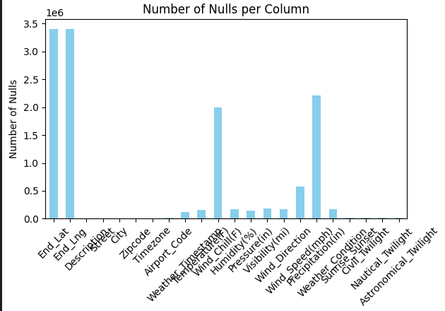
Nulls in Data
Some Columns have a lot of missing values

Slide 6
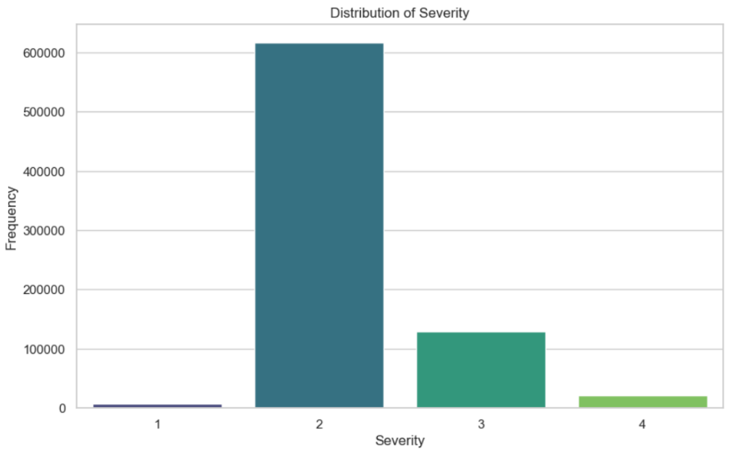
Severity Distribution
Severity 2 is dominating

Slide 7
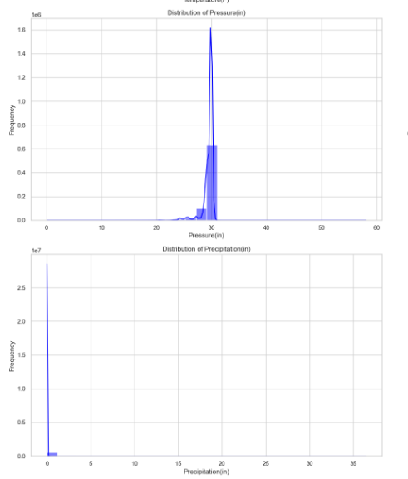
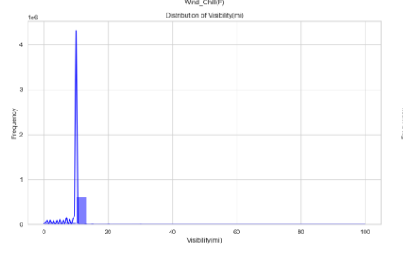
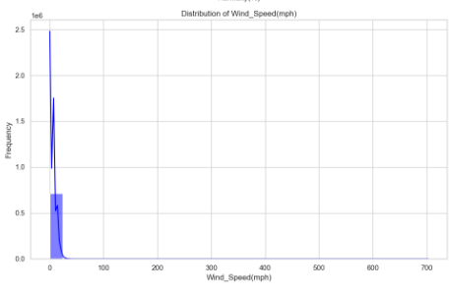
Outliers
Some columns have outliers

Slide 8
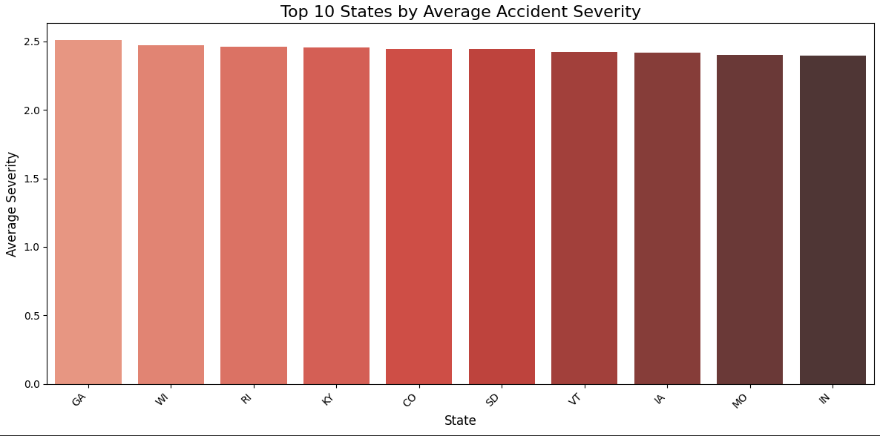
Avg Severity per state
Uniform Distribution

Slide 9
Data Cleaning

Slide 10
Irrelevant Columns
Eliminates columns that don’t provide meaningful data for modeling or analysis.
Columns such as ID, Source, Description, Street, City, Zipcode, Airport_Code, etc., are dropped as they are not useful for analysis or prediction tasks.

Slide 11
Handling Missing Values
Dropping Columns like End_Lat & End_Lng as the percentage of missing values was greater than 40%
Imputing missing values in numeric columns by inserting the mean value
Imputing missing values in categorical columns by inserting the mode value

Slide 12
Outliers
Eliminating records with temperature higher than 56.7 C as reported in this article that the maximum US temperature was 134.4°F (56.7°C)
For Wind Speed values, we identified outliers by considering the maximum observed wind speeds. According to the World Meteorological Organization, the highest recorded wind speed was 254 mph (408 km/h). We decided to remove any records with wind speeds exceeding this threshold to eliminate extreme outliers.
We used IQR in other columns

Slide 13
Feature Engineering

Slide 14
Adding Road-Related Features
A Boolean variable Is_Complex_Road was added to interpret whether the road is complex by utilizing the other variables like (Junction, Railway, Crossing)
This will help in giving insights into the effect of complexity of roads.

Slide 15
Risk Score
The dataset was aggregated at the state level to simplify the analysis and provide actionable insights at a regional scale.
Key metrics such as average accident severity, total accident count, and risk score were computed for each state.
The Risk score was calculated as the product of average severity and accident count, capturing both the frequency and severity of accidents.
The Risk score was then normalized to be from 0 to 1.
Also, A Boolean variable Is_High_Risk was added to detect if a state was high risky or not by using the 75th quartile.

Slide 16
Time Related Features
Hour of the Day: Captures the time of day when accidents occur (e.g., morning rush hours, nighttime)
Day of the Week: Identifies whether accidents are more frequent on weekdays or weekends.
Month: Highlights seasonal trends in accident occurrences (e.g., higher rates during winter months due to adverse weather conditions).
Year: Tracks long-term trends in accident frequency over multiple years.
Duration: Tracks the duration of the accident in minutes by subtracting the start time from the end time
Season: Determines the Season when the accident happened (Summer, …)

Slide 17
Outliers
Eliminating records with temperature higher than 56.7 C as reported in this article that the maximum US temperature was 134.4°F (56.7°C)
For Wind Speed values, we identified outliers by considering the maximum observed wind speeds. According to the World Meteorological Organization, the highest recorded wind speed was 254 mph (408 km/h). We decided to remove any records with wind speeds exceeding this threshold to eliminate extreme outliers.
We used IQR in other columns

Slide 18
Outliers
Eliminating records with temperature higher than 56.7 C as reported in this article that the maximum US temperature was 134.4°F (56.7°C)
For Wind Speed values, we identified outliers by considering the maximum observed wind speeds. According to the World Meteorological Organization, the highest recorded wind speed was 254 mph (408 km/h). We decided to remove any records with wind speeds exceeding this threshold to eliminate extreme outliers.
We used IQR in other columns

Slide 19
Accidents based on Time

Slide 20
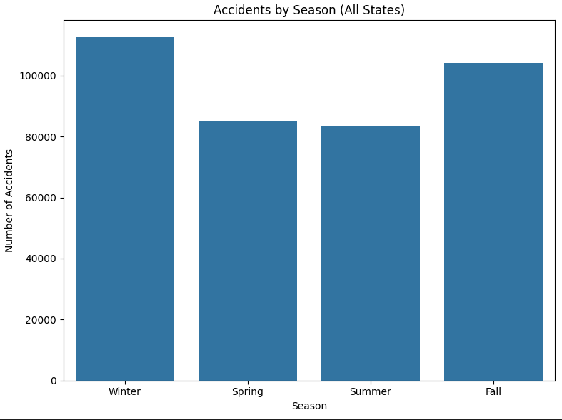
Accident Trends by Season.

Slide 21
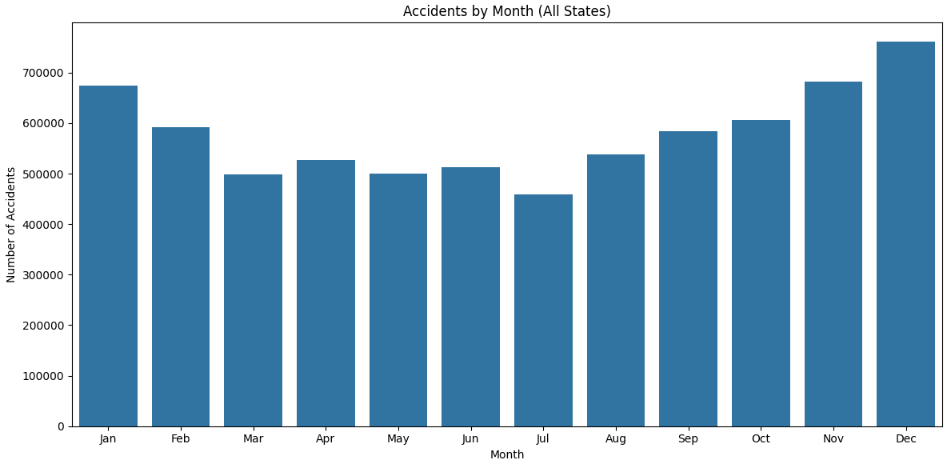
Accident Trends by Month.

Slide 22
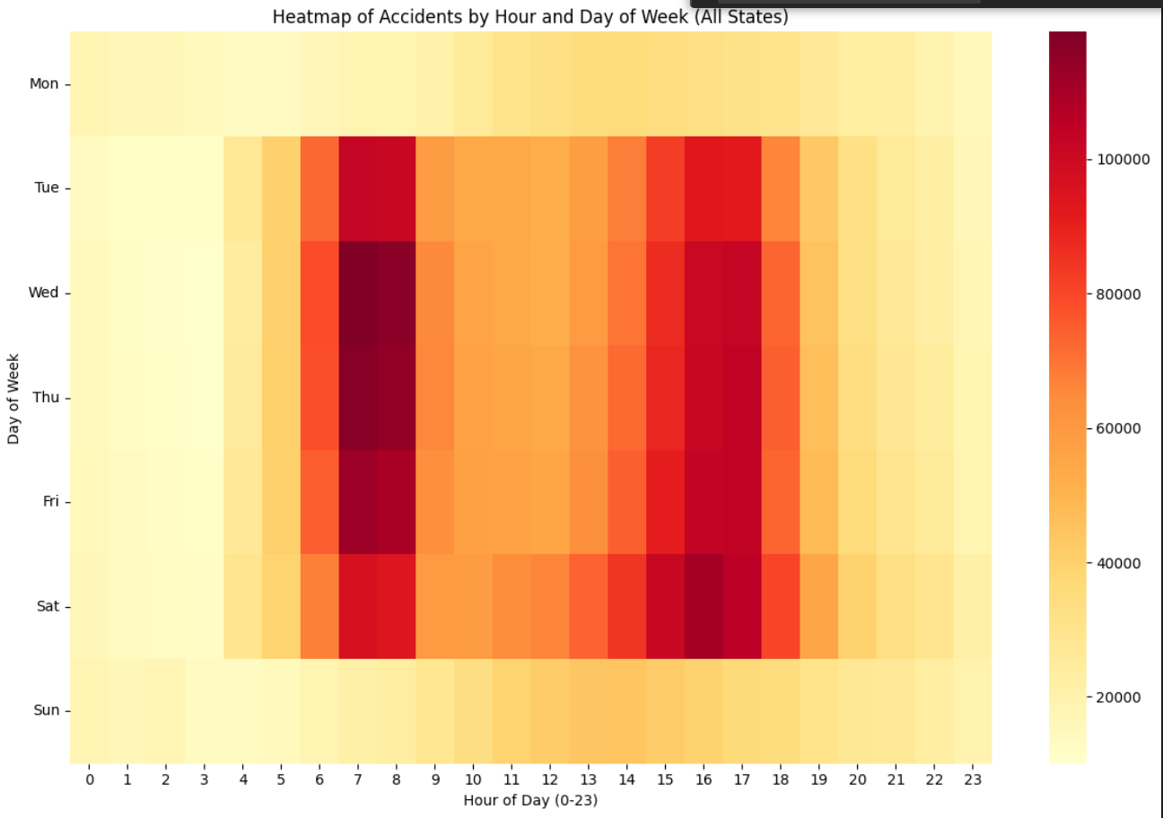
Accident Trends by Hour.

Slide 23
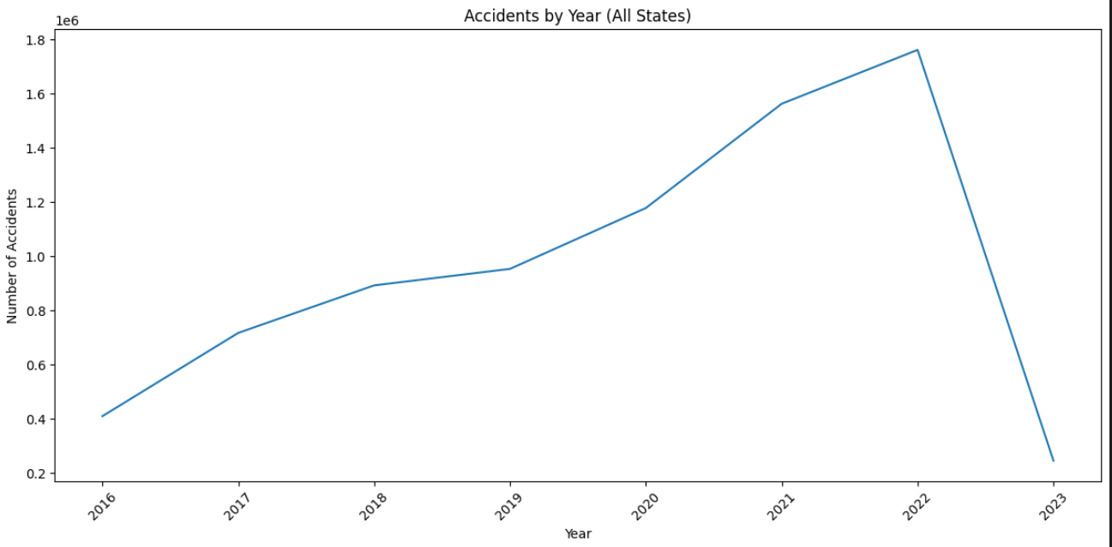
Accident Trends by Year.

Slide 24
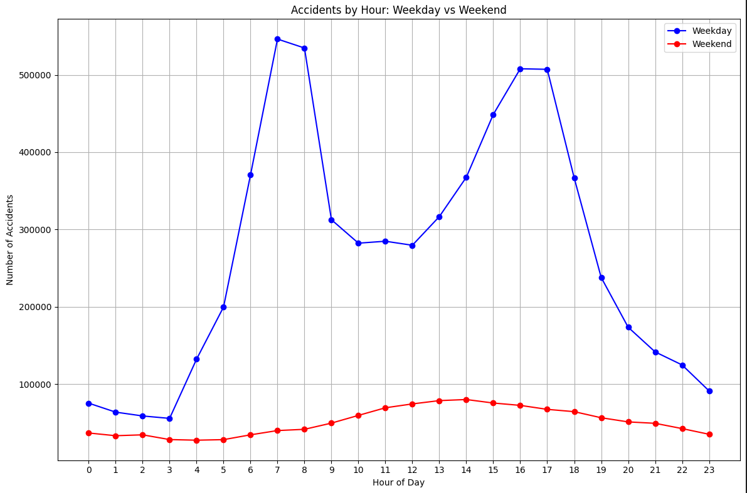
Weekends and Weekdays behavior

Slide 25
Weather Effect on Accidents

Slide 26
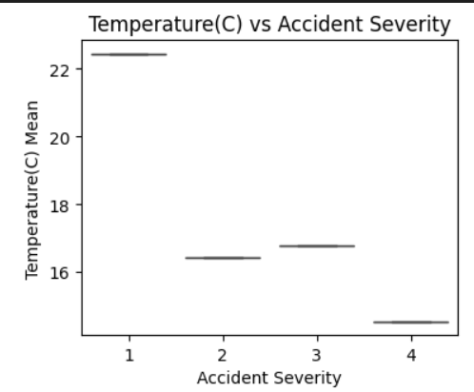
Temperature & Severity

Slide 27
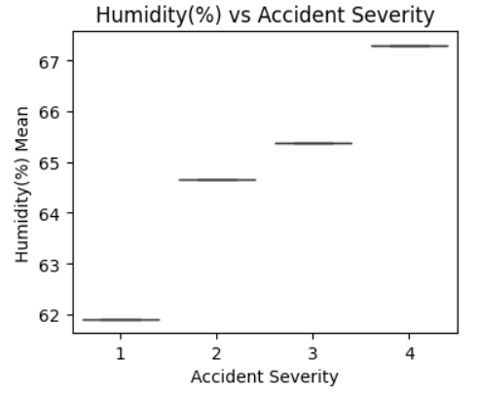
Humidity & Severity

Slide 28
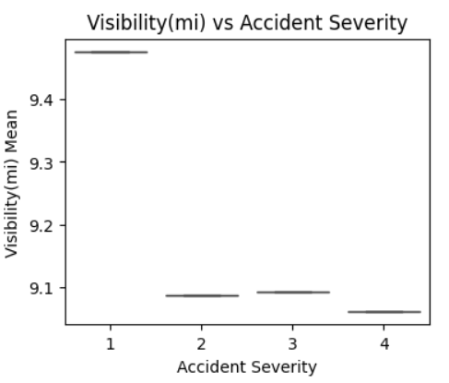
Visibility & Severity

Slide 29
Accidents based on Location

Slide 30
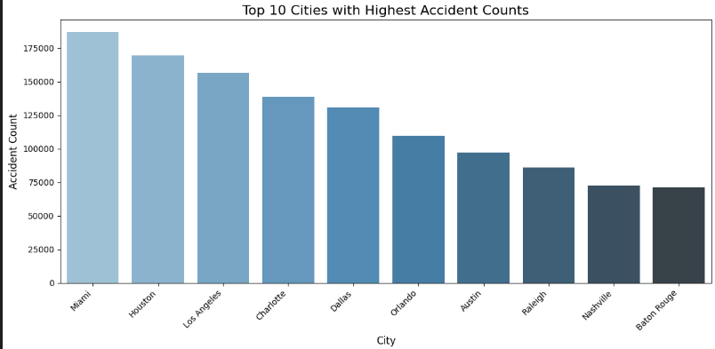

Slide 31
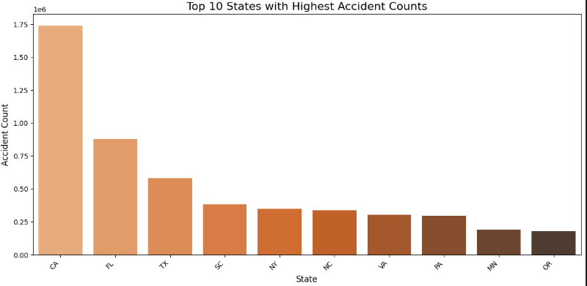

Slide 32
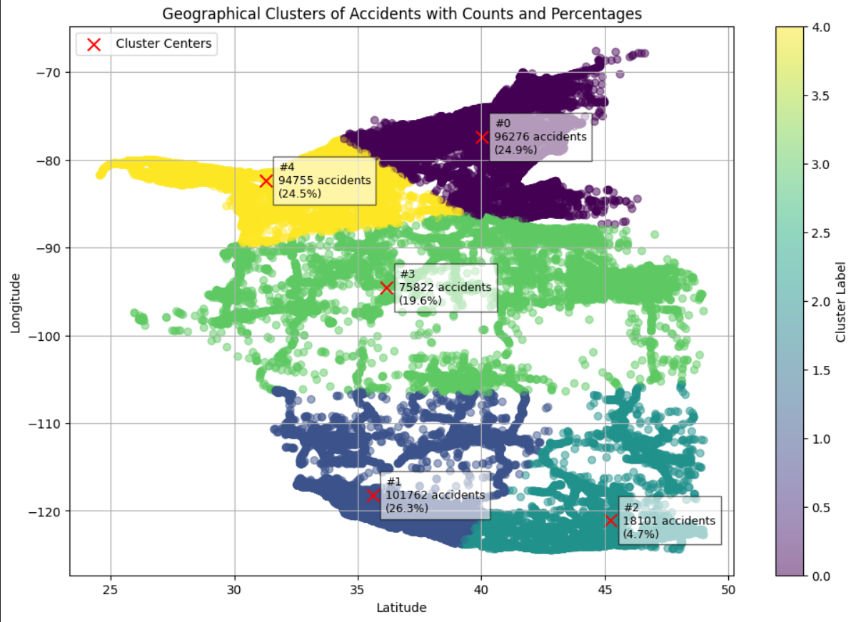
Top 5 Clusters in US with Accidents

Slide 33
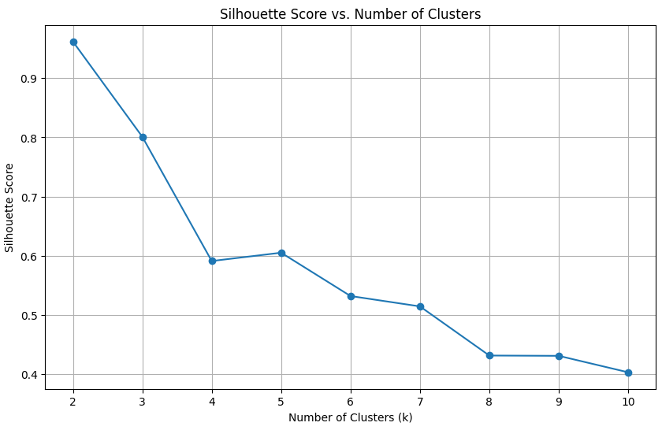
Silhouette Score

Slide 34
Road Conditions & Accidents

Slide 35
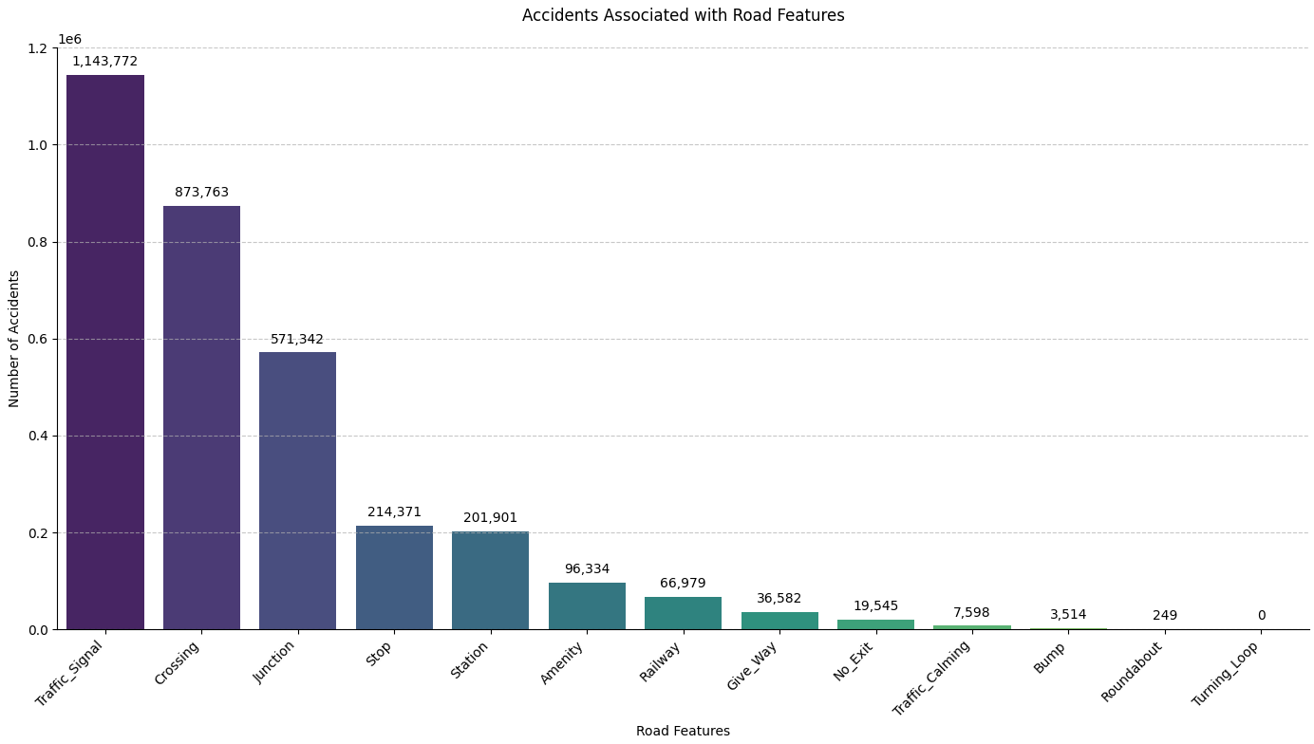

Slide 36
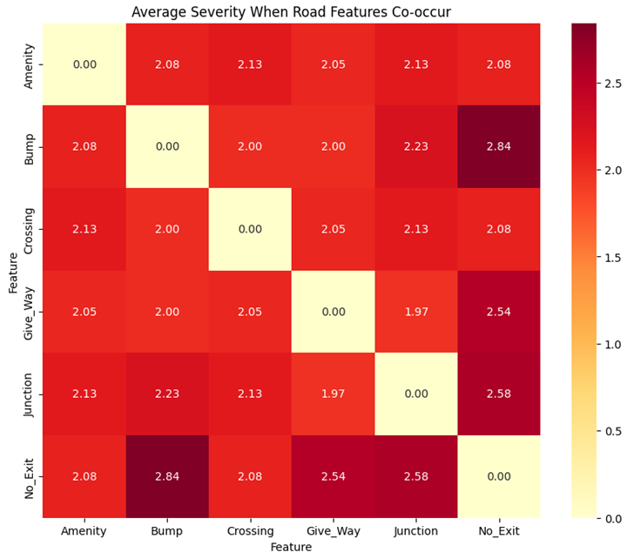

Slide 37
Predicting Severity & Risk

Slide 38
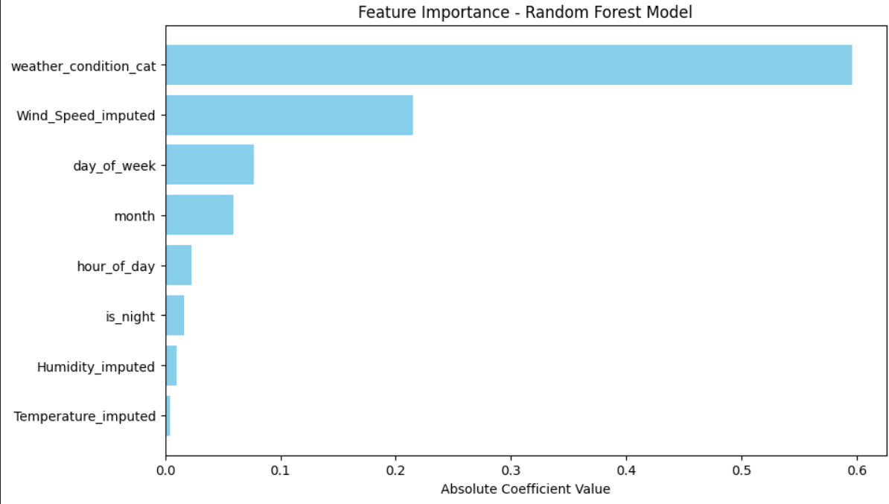
Multiclass Classification

Slide 39
Binary Classification for Severity
Model | AUC | F1 | Accuracy
Logistic Regression | 0.7297 | 0.7492 | 0.8077
Random Forest | 0.7509 | 0.7184 | 0.8053
Gradient-Boosted Trees | 0.8089 | 0.7660 | 0.8192
Decision Tree | 0.6452 | 0.7438 | 0.8112

Slide 40
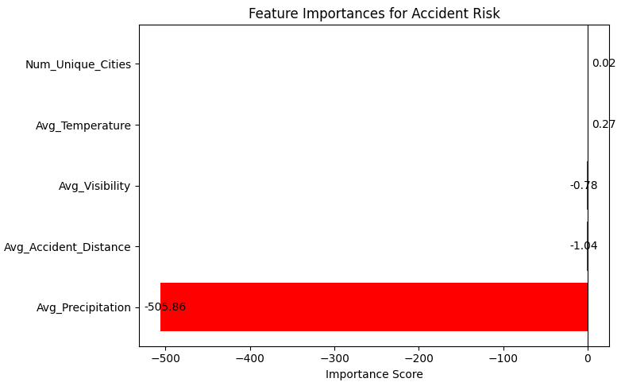
Risk Classification for States

Slide 41
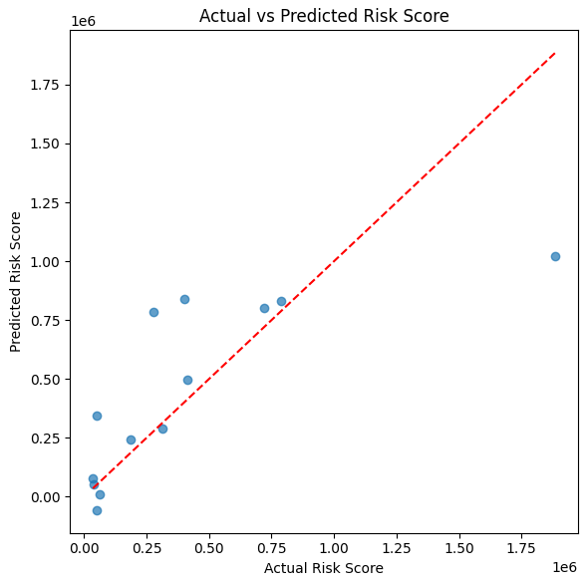
Risk Prediction using Regression

Slide 42
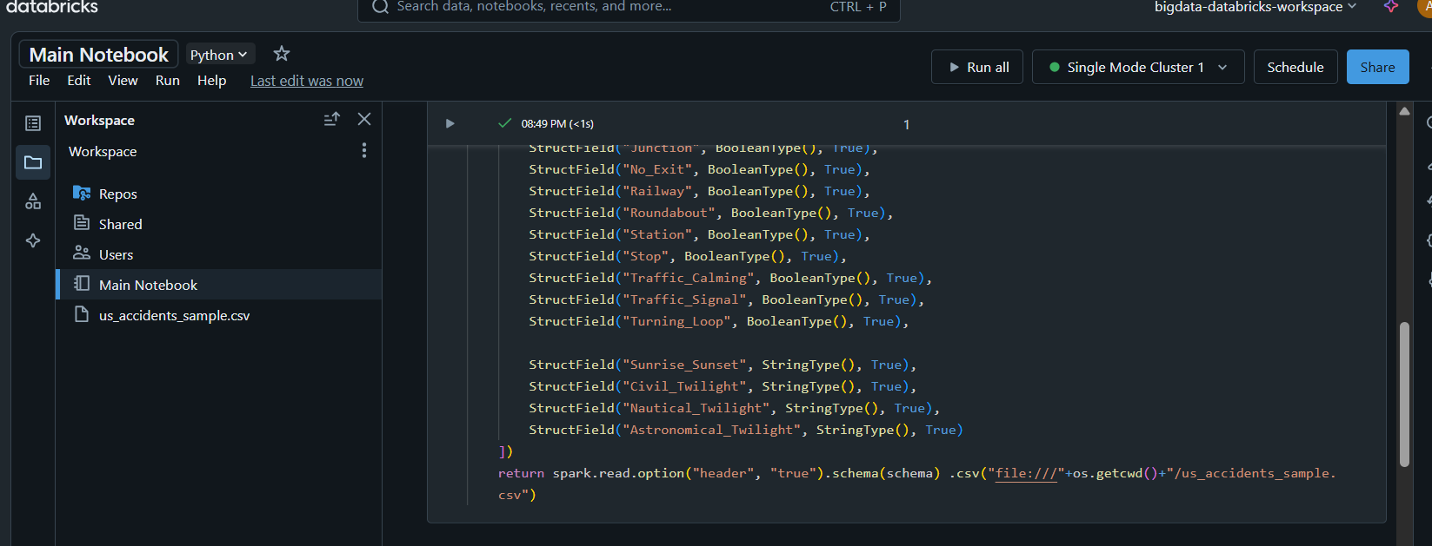
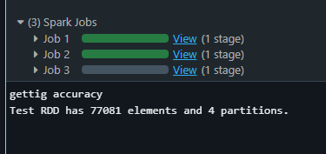
Azure Databricks

Slide 43
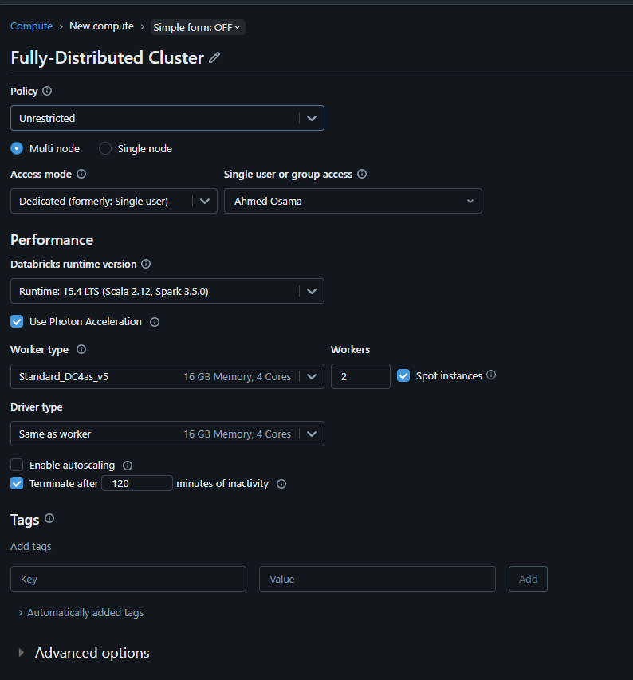

Fully Distributed Mode

